Slide 1
TechXChange – Microsoft Track

Slide 2
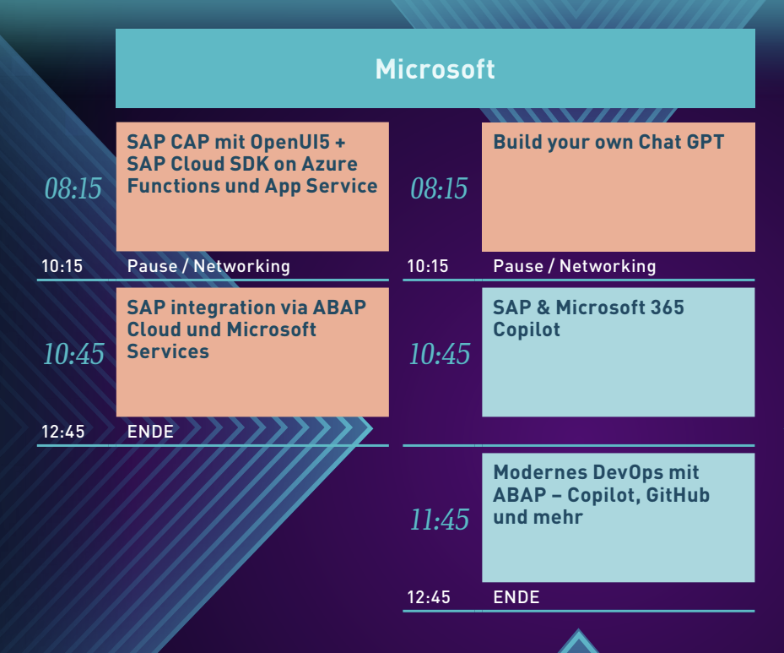
https://github.com/martinpankraz/dsagtechxchange24

Slide 3
SAP CAP on Azure

Slide 4















Azure Cosmos DB for PostgreSQL
(powered by citus extension)
Azure
Microsoft Entra ID
(formerly Azure AD)
Resource Group
Codespaces
App Service
powered by
App Service Plan
(F1: Linux, free)
SAP CAP
azd up
Key Vault
Log Analytics
OData
App Insights
Shared Dashboard
for „upped“ app
Entra ID App Registration

Slide 5



Azure Cosmos DB for PostgreSQL
(powered by citus extension)
Azure
Microsoft Entra ID
(formerly Azure AD)
Resource Group
Codespaces
App Service
powered by
App Service Plan
(F1: Linux, free)
SAP CAP
azd up
API
Management
API register
git push
Key Vault
API
Policy
azd up
Log Analytics
OData
GitHub Action
App Insights
Shared Dashboard
for „upped“ app
Entra ID App Registration
authorized

Slide 6
ABAP Cloud with Microsoft

Slide 7
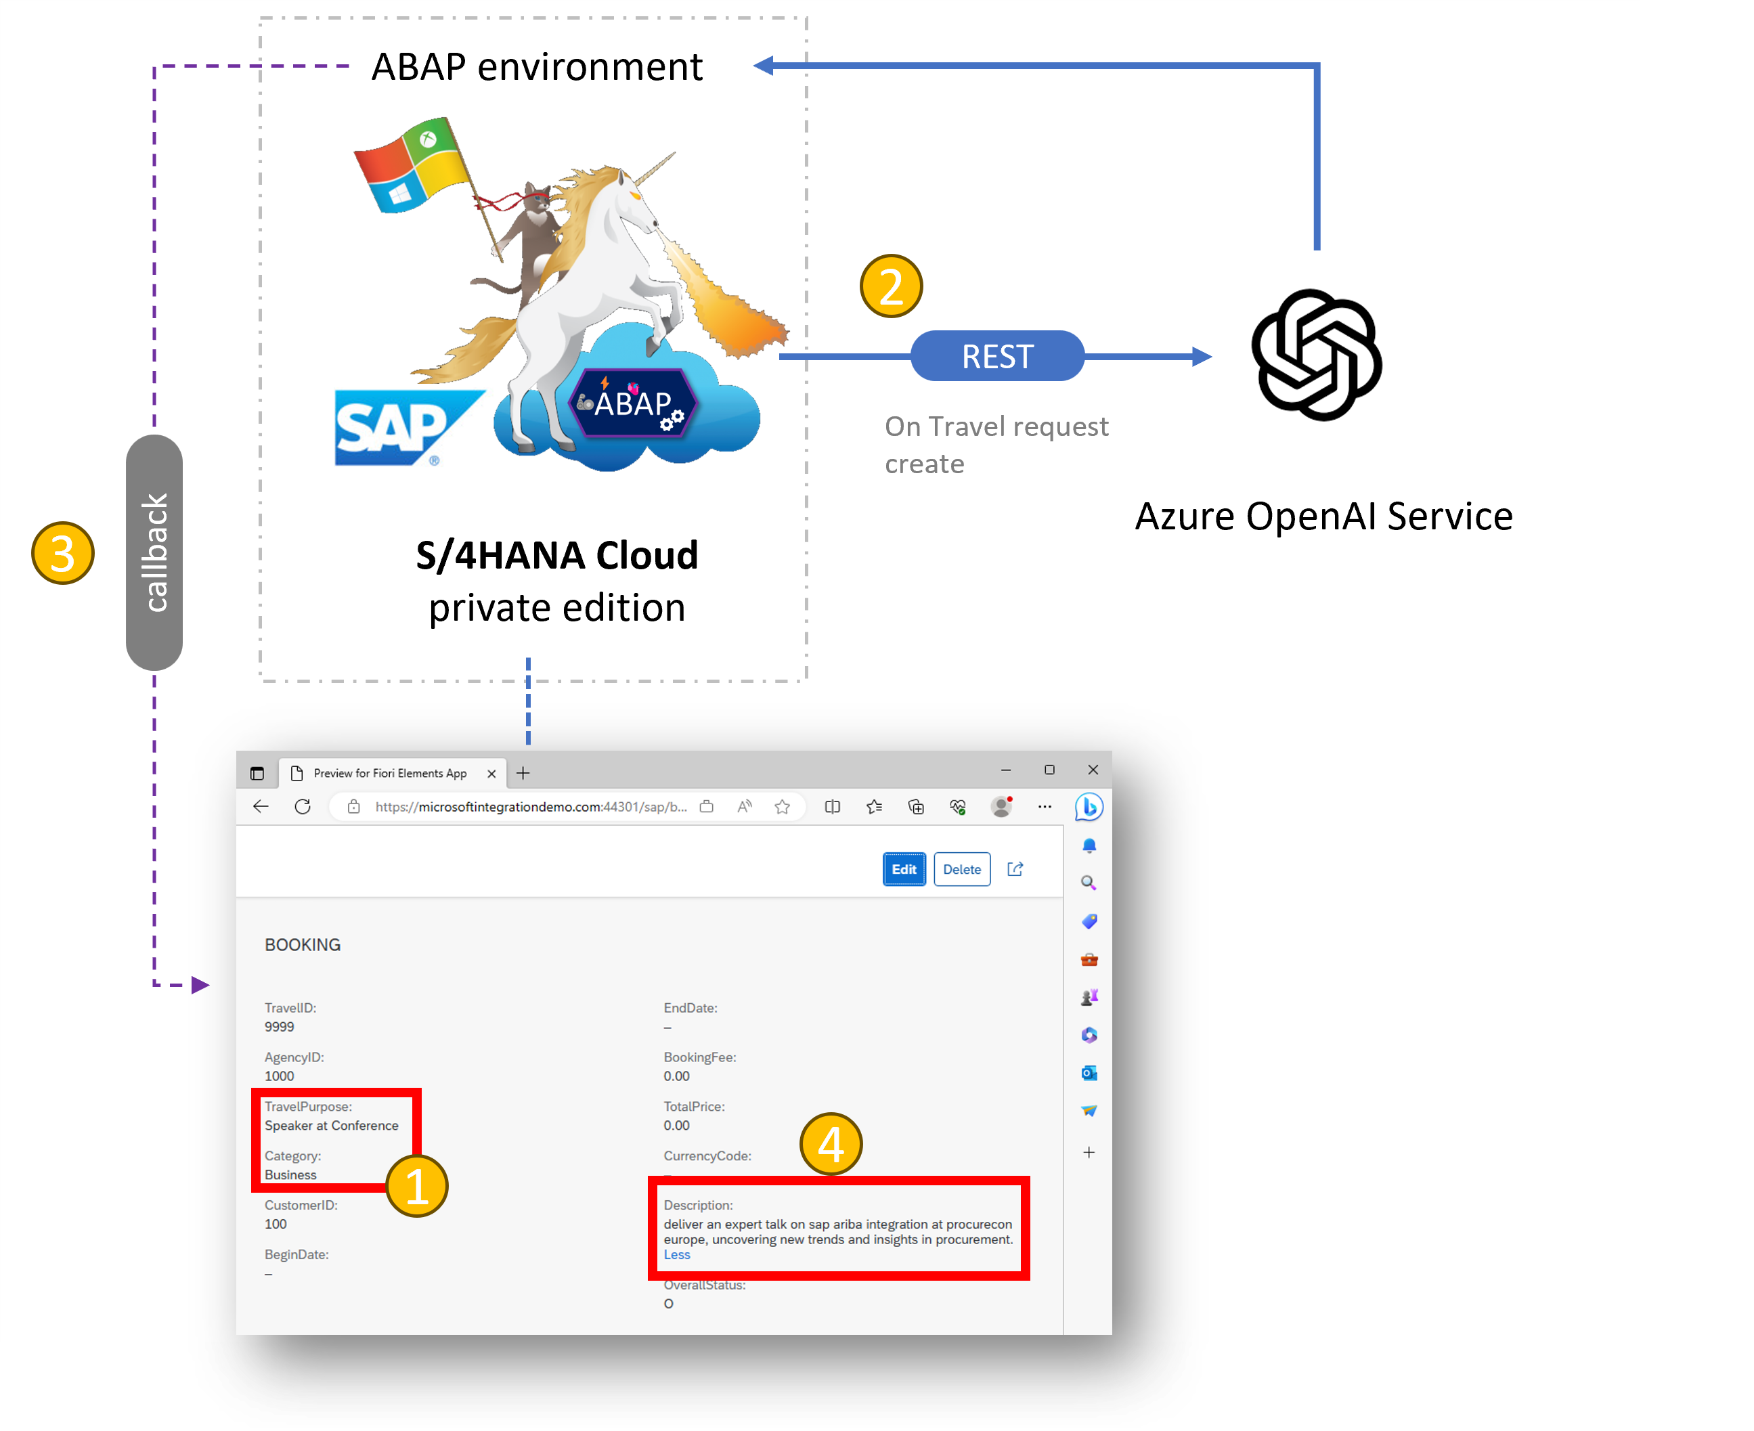
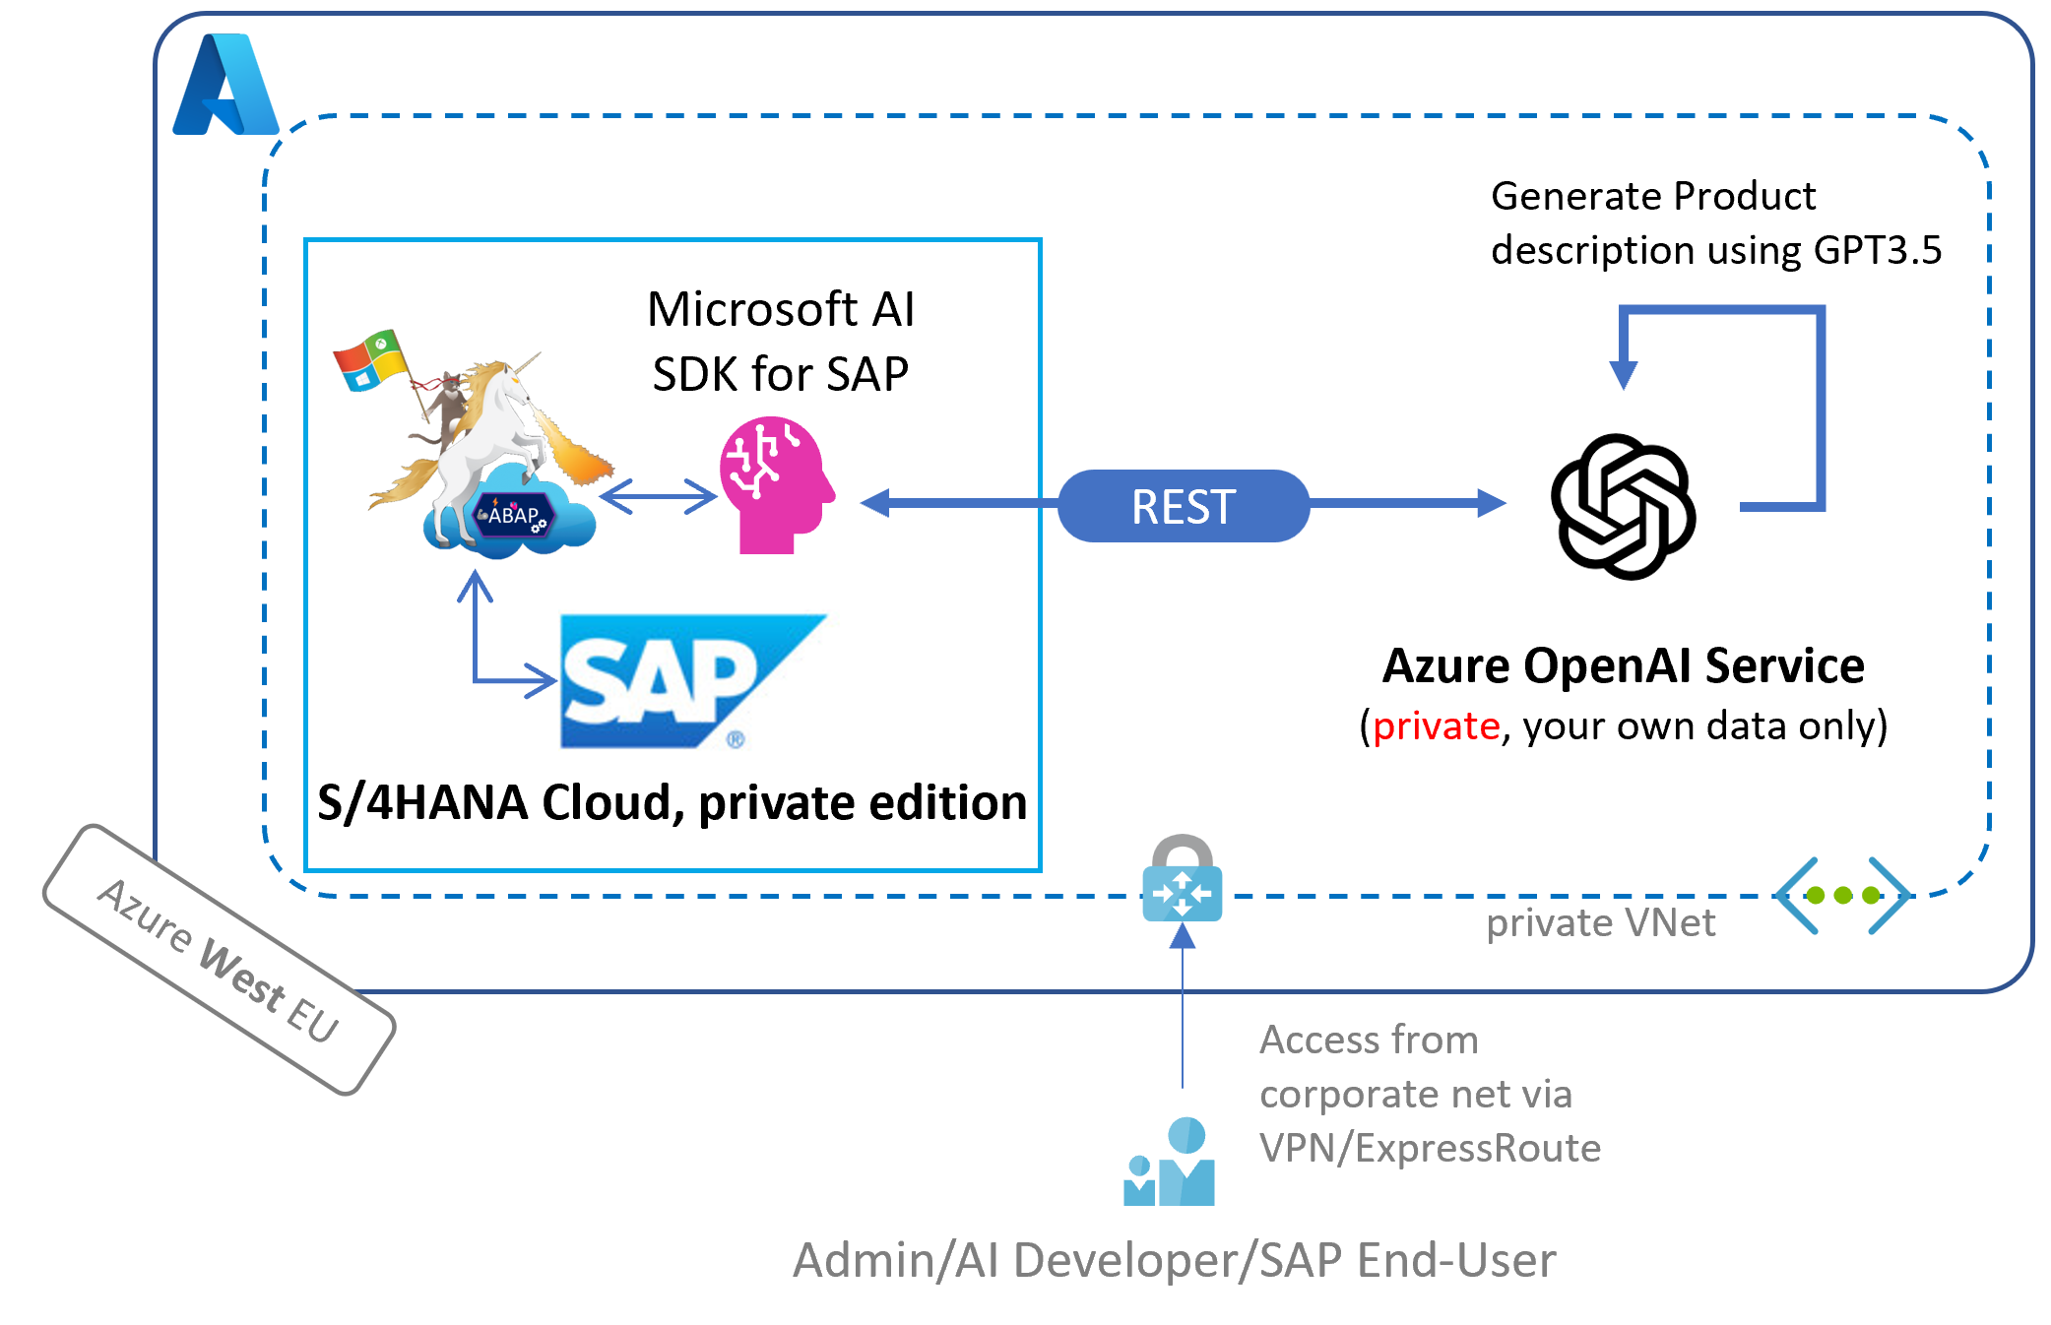

Slide 8
Build your own ChatGPT

Slide 9
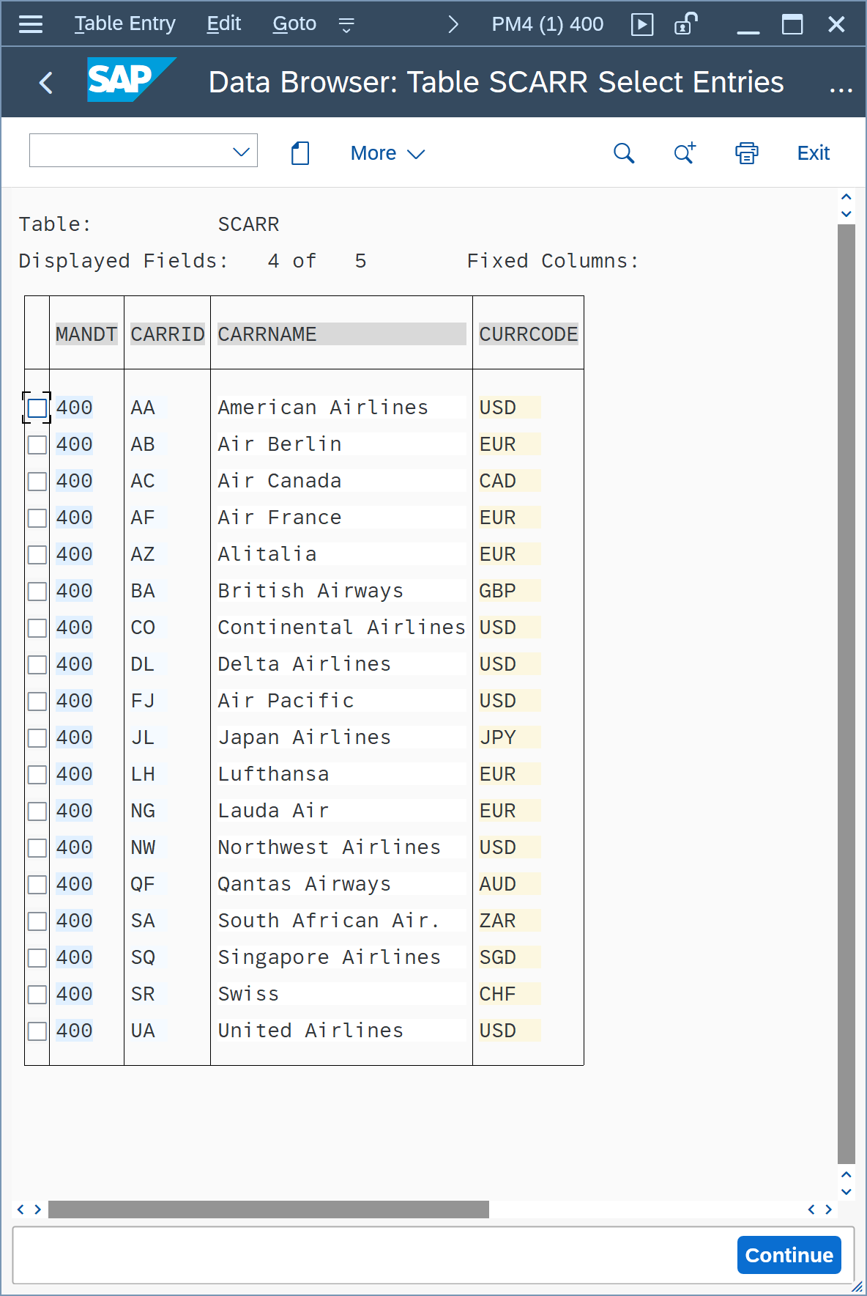
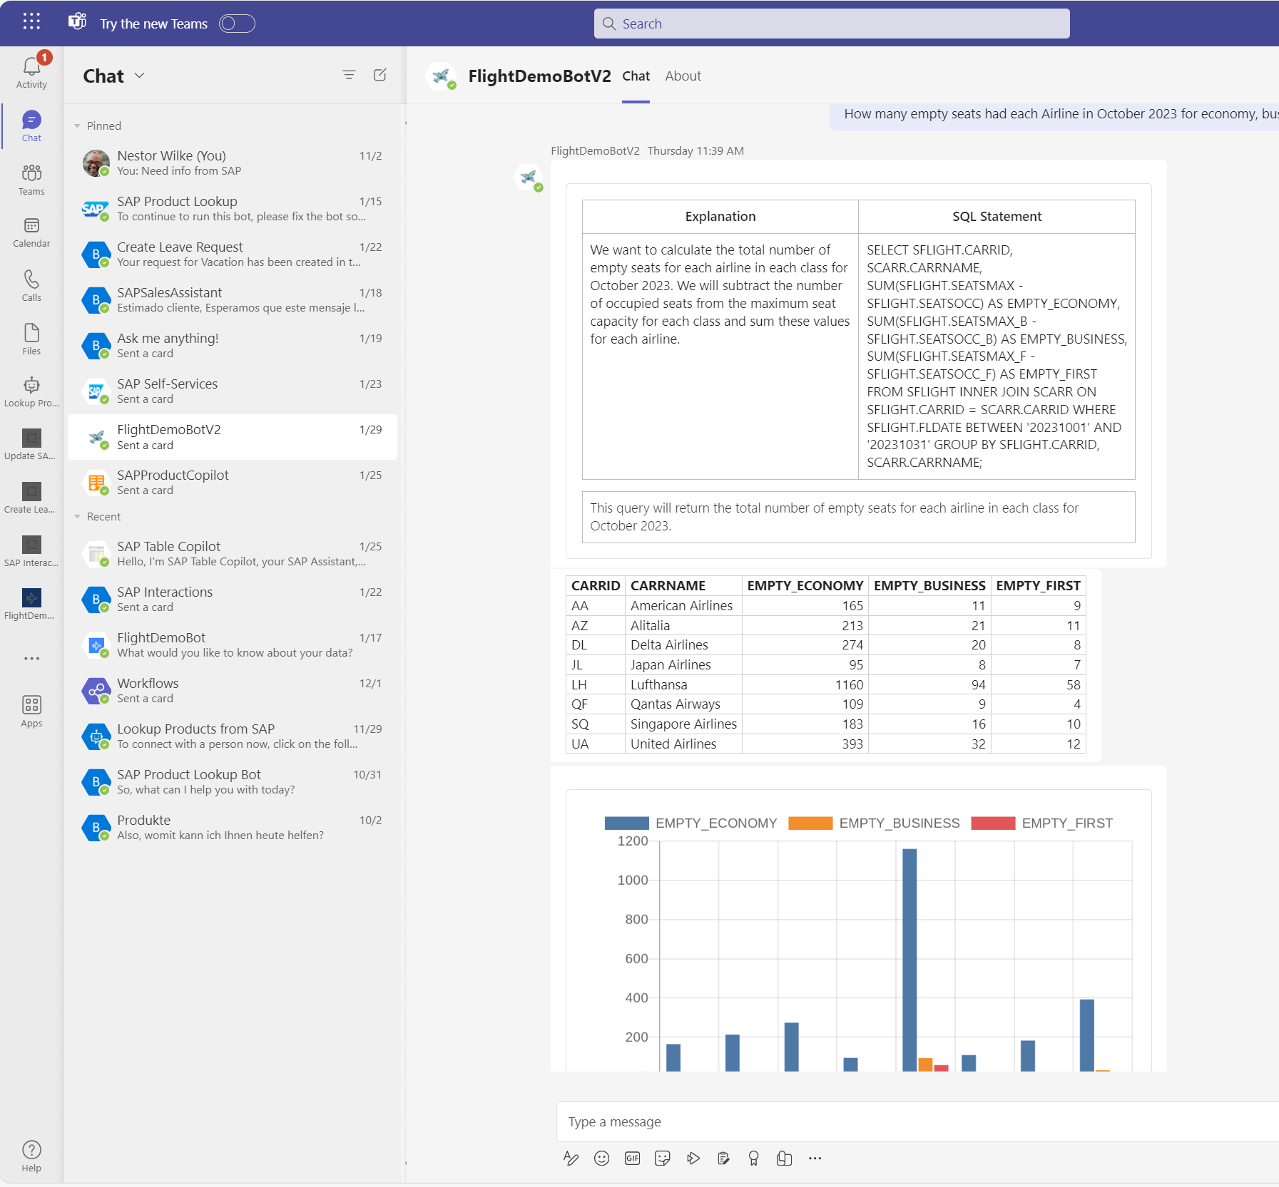
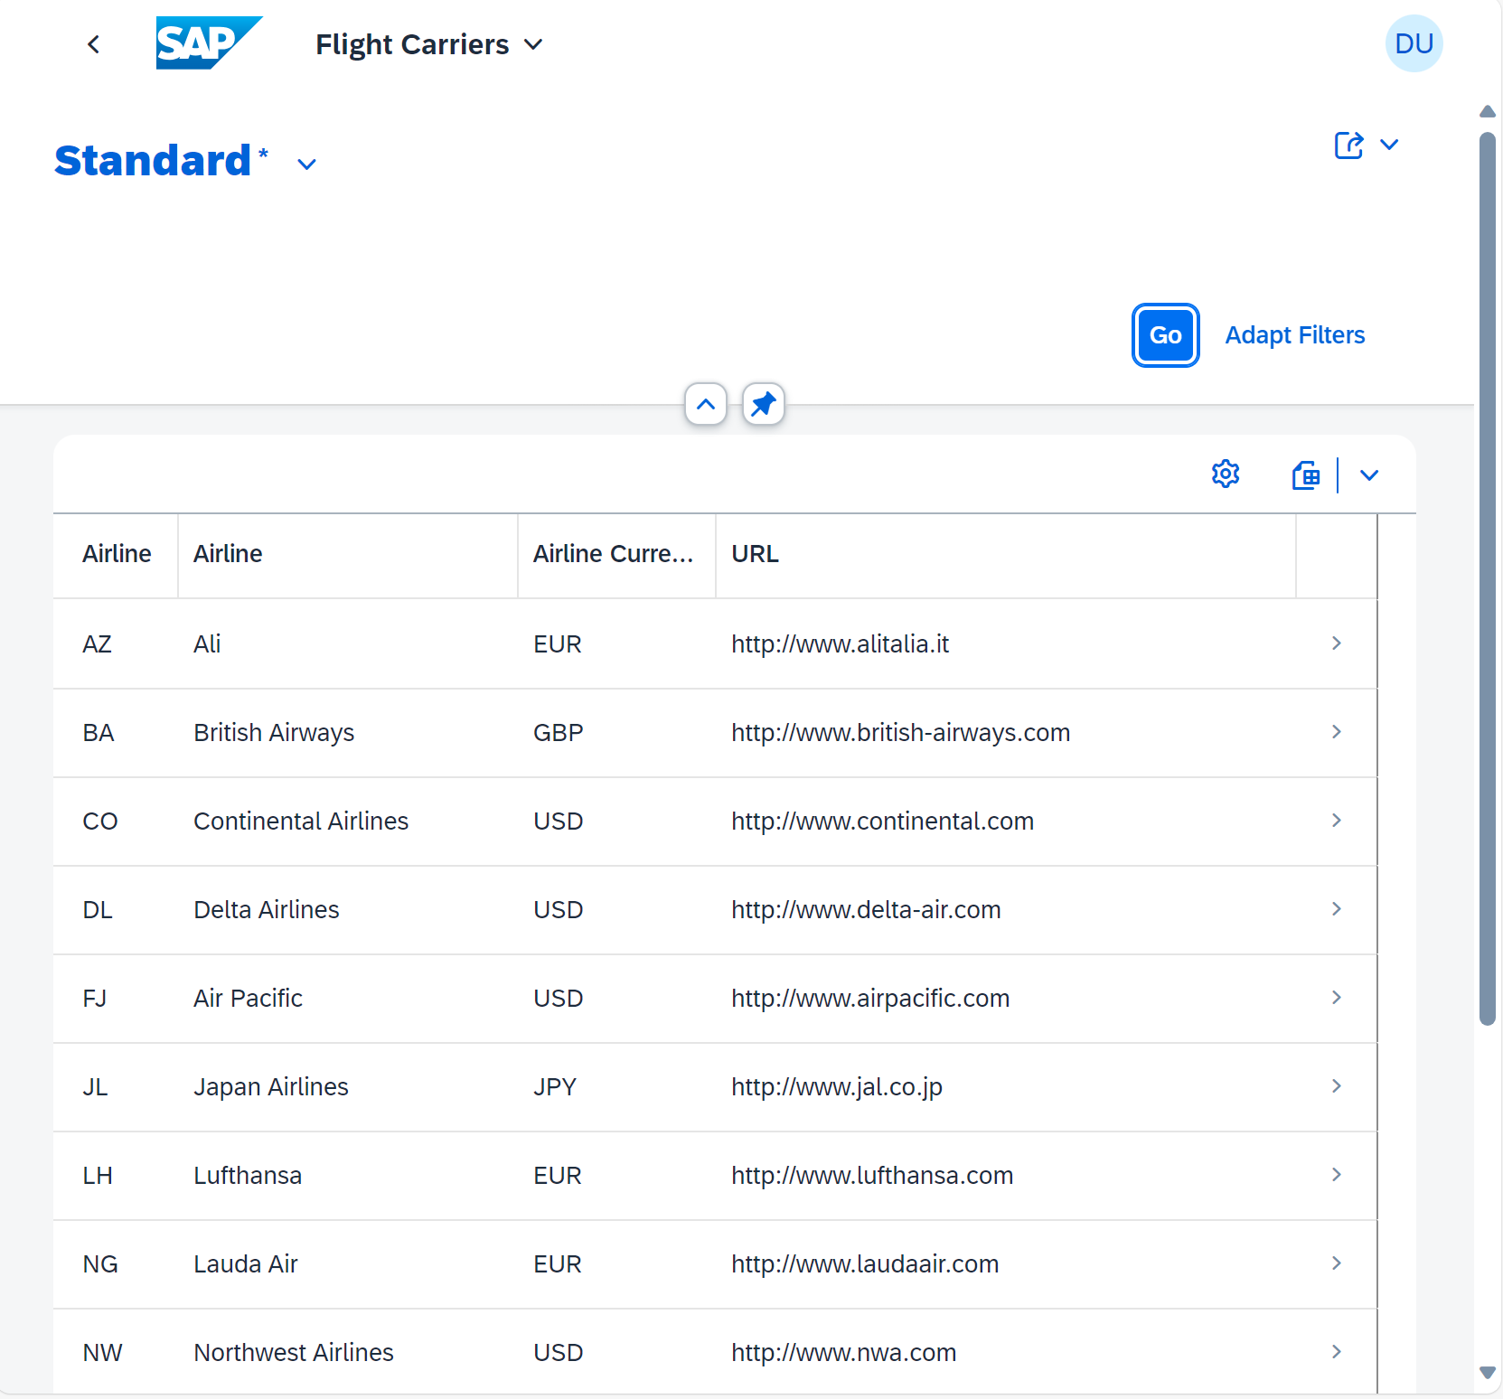
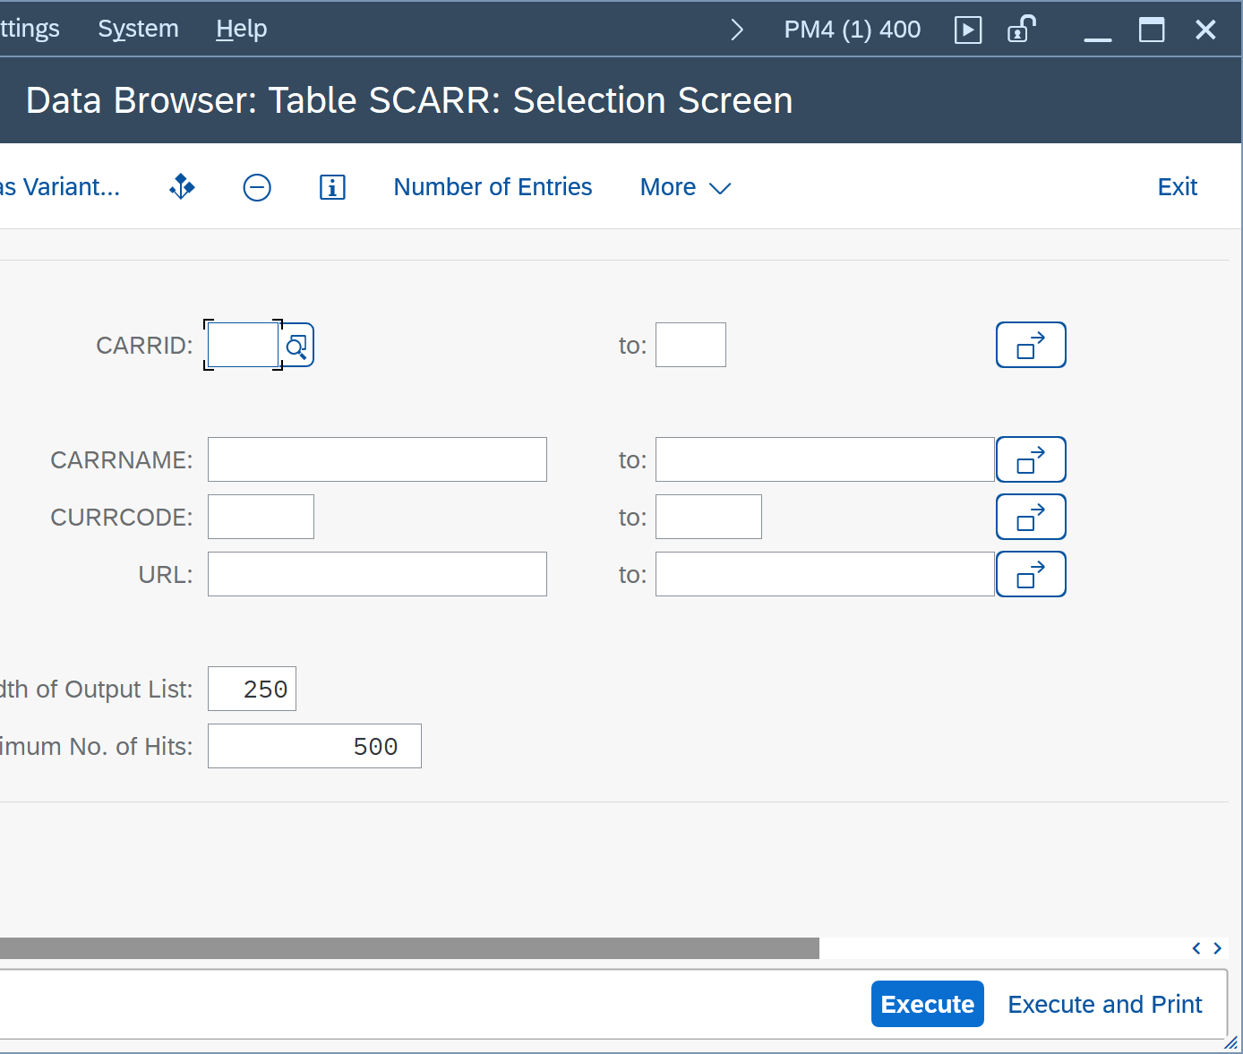
ChatBots?!?
TERMINAL
UI
Chat with AI
Expert Systems
You need to know what and how
Everyone can use it
The app defines / limits what you can do
Everyone can use it
Explore what‘s possible

Slide 10
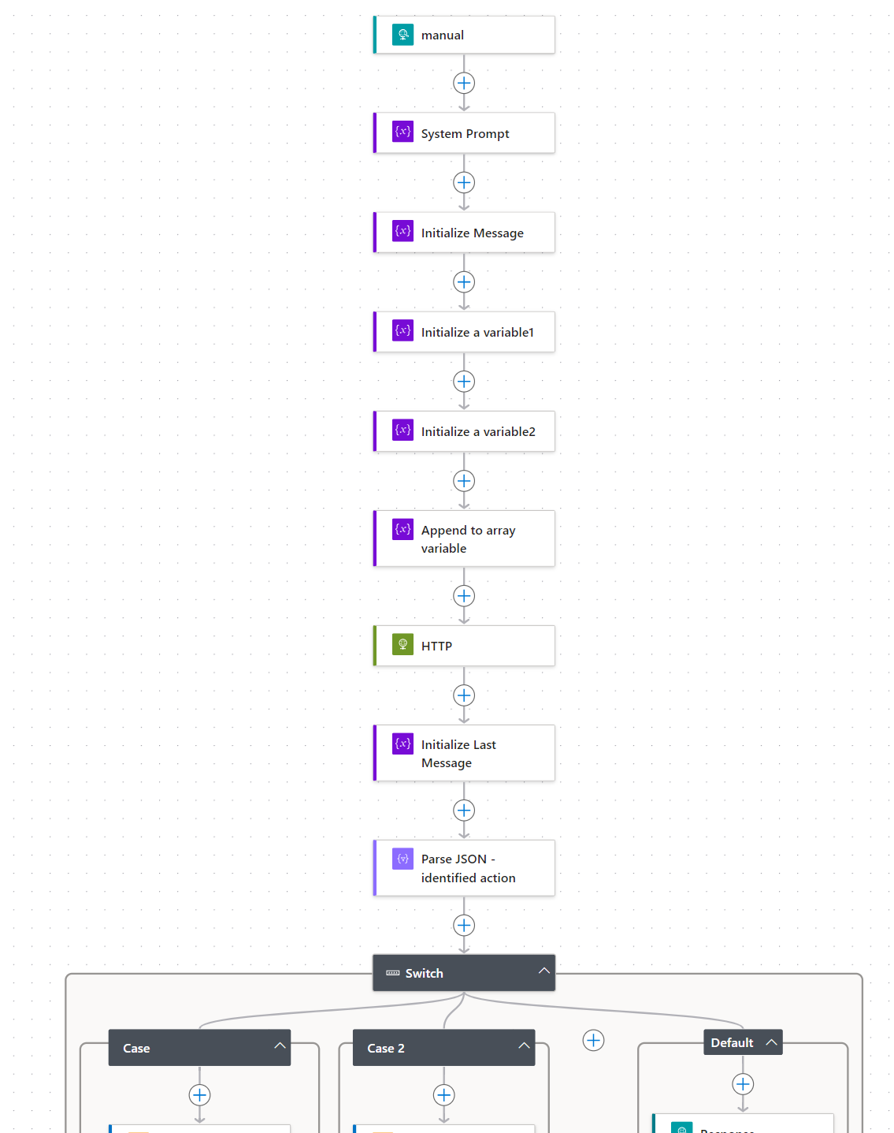


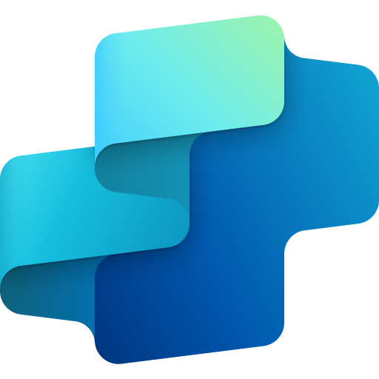


Public Website / SharePoint
Power Automate
Generative AI
Copilot Studio
Azure Open AI
Documents

Slide 11
Credentials für heute gibt’s hier
👇
https://aka.ms/dsag-tt-24-microsoft

Slide 12
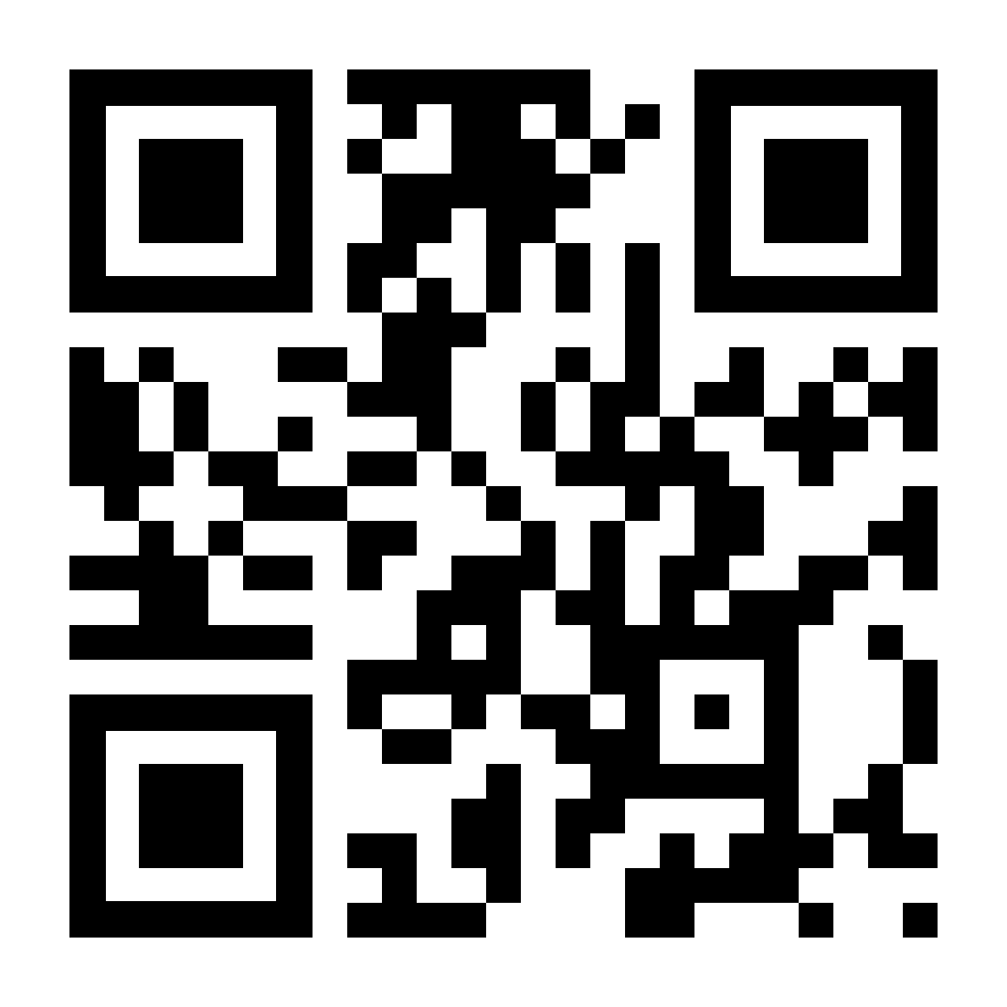

Roadmap-Wünsche, Feedback und Projekt-Ideen gerne im Gespräch direkt an uns. Link bleibt 30 Tage offen.
📬martin.pankraz@microsoft.com
📬holger.bruchelt@microsoft.com
https://www.linkedin.com/in/martin-pankraz/
https://www.linkedin.com/in/holger-bruchelt/
https://aka.ms/meet-martin

